Slide 1

ProtoControl
Kelly Mae Allen, Abisha Fenn, Nida Kosedagi, Parker Sexton, William Wood

Slide 2
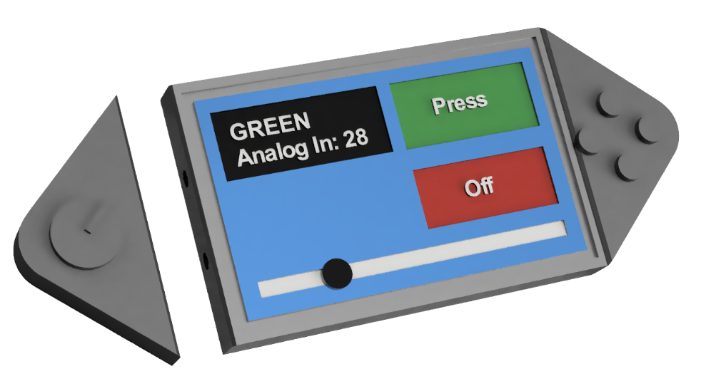
Agenda
Protocontrol Overview
New User System Demo
New Hardware Peripherals Demo
PCB
Integration
Demo Day Plans
Notes:
Hardware Peripherals
Show swapability
Keypad
Rotary Encoder
Scanning Function
Begin Function
Next Steps
Multiple components on the same pcf8574 chip
Port Design
Slider (next purchase order)
Product Requirements:

Slide 3
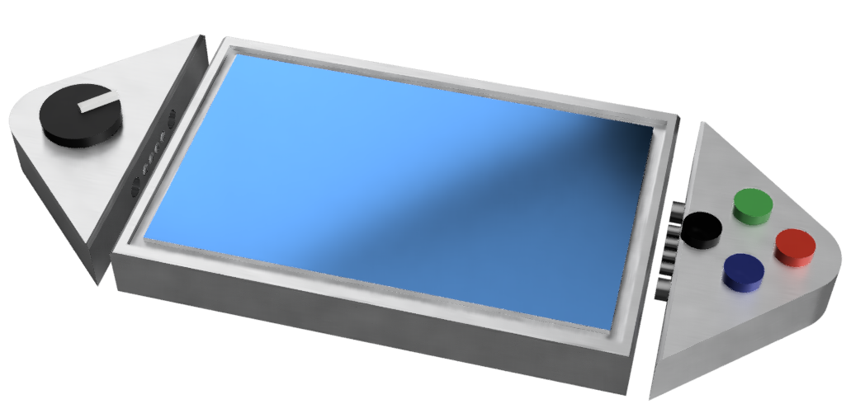
What is ProtoControl?
A plug and play panel with a start-to-finish user interface development experience.
Software platform to design user interface layout
Auto generated embedded code
Touch-screen display
Hot swappable hardware
Compatibility with industry standard technology
Nida Kosedagi
Notes:
Protocontrol allows engineers and hobbyists to execute their vision for a user interface panel with a start-to-finish user interface development experience
Bring the audience to the same place as us before diving into details, set the tone, differentiate ourselves from other projects

Slide 4


Example Users
Shannon
Senior Embedded Engineer
Tasked with designing a test bench for a production line
Needs to have prototype ready ASAP
Julia
10th Grade
Familiar with simple block coding
Wants to make cool projects
Needs to easily display values
Abisha Fenn & Kelly Mae Allen
Notes:
Meet Julia. Julia represents our hobbyist market. Julia is in 10th grade. She has some experience with simple block coding but wants to branch out with some personal projects. Unlike Shannon, her critical constraint isn’t time. She needs something that can manage complexity without having a high barrier to entry.

Slide 5





Meet The Team
Kelly Mae Allen (Team Lead)
Enclosure modeling & Power
Embedded software integration
Parker Sexton (Project Sponsor)
Embedded Software Integration
Software/website, Custom PCB design
Will Wood
Software and Website to Design Digital UI
Nida Kosedagi
Custom PCB Design
Serial Communication IC
Abisha Fenn
Serial Communication IC
Enclosure Modeling & Power

Slide 6

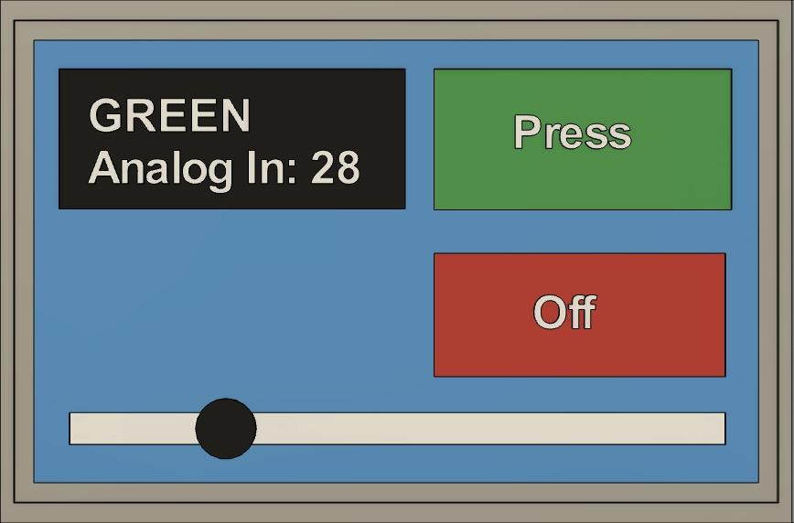
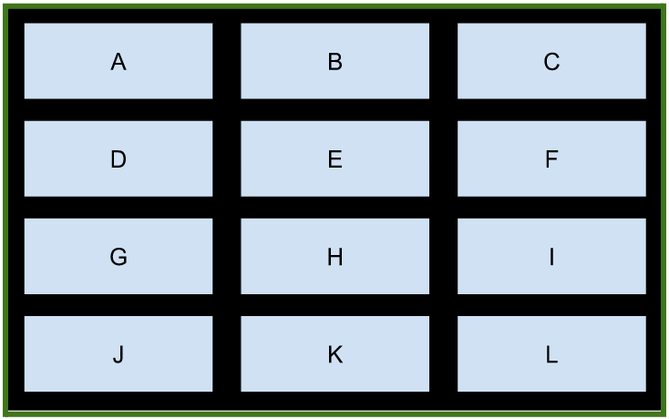

Integration between Protocontrol and User System
Command Protocol
+[component tag]|[value]
Notes:
Not rlly sure how this slide is relevant, at the very least it should not be the first slide for this subsystem

Slide 7
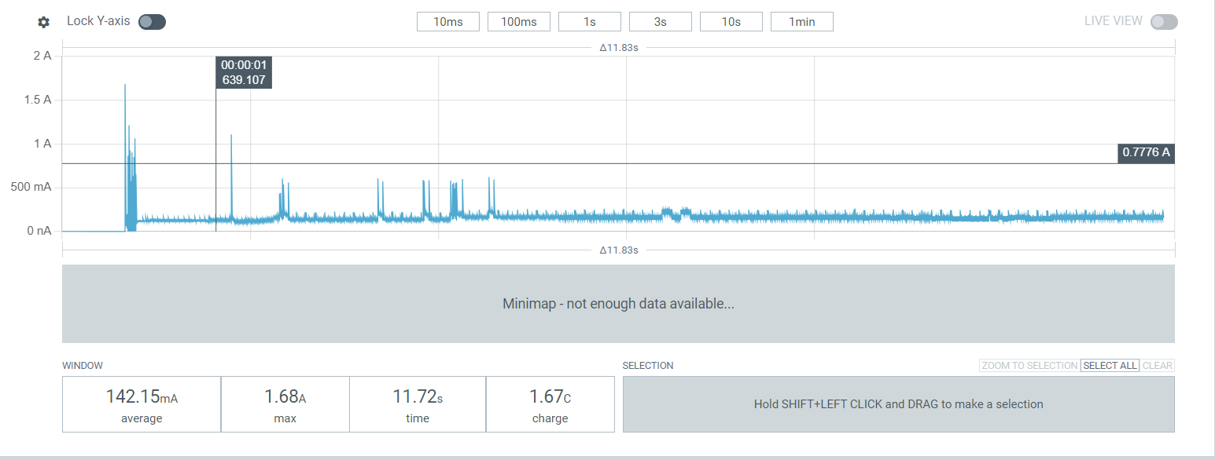
Power Analysis

Slide 8
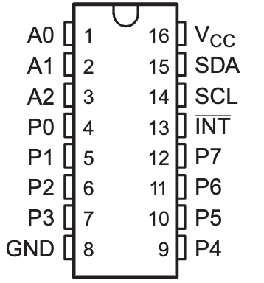
Hardware Peripheral Demo
Beta Demo Plan | Current Achievements
Integrate Hardware Peripherals with Main Board | Initialization Steps, printing out received data, Stable data, swapability (re-flash required)
Multiple Components Connected at Once | Buttons, Keypad, Rotary Encoder!
Hot Swapability | Both ports on PCB work with multiple peripherals (control servo angle)
Port Design | Pogo pins with magnetic connectors
User creates I2C component configuration | Circumvent Website; instead use flag system to check certain known addresses
Remaining Items: Analog Components (slider) with ADC breakout board

Slide 9

Embedded System Demo Plan
Working with new user system
Fixed reliability issue to use pointers
Since Alpha Demo:
Created Serial Echo and debug output
I2C component INIT

Slide 10

Website Updates
Since Alpha Demo:
Polishing
Added
Location ID
Configured endpoints for multiple devices

Slide 11

PCB update
One More PCB!
Moved barrel jack
Connected VCC pours
Added INPUT_PULLUP variable for the switch/I2C interference issue
Added missing traces
Component PCB tested and working!

Slide 12

Possible added features
WIFI setup mode
local web server used to set ID and connect to wifi
Analog components using ADC
Multiple Components on the same chip
(button layout similar to keypad)

Slide 13
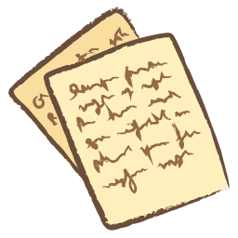
Documentation
User Manual
Assembly Document
Technical Specifications

Slide 14
Demo Day Plan

Slide 15
Demo Overview
Three User system examples
Team 33 Collaboration
Demonstrate all features of device
Hotswap protocontrol between user systems
Live demo of changing UI layout
User Manuals printed
Detailed walkthrough of how all communication and setup works

